Slide 1



BrightBoard | 4/23/2025
PROJECT
BRIGHTBOARD
Final Presentation
NAME OF PROJECT:
PRESENTED BY:
BrightBoard
Nicholas, Ritanshu and Muhammad

Slide 2


01 | Welcome and Introduction
02 | What is BrightBoard
03 | Frontend Overview & UI Features
04 | React Structure & Component Design
05 | Backend Logic & Database Integration
06 | Database Structure & Models
07 | Demo
08 | Q&A / Feedback
Agenda

Slide 3




Our team
Nicholas Weikl
Muhammad
Ritanshu Singh
Back end
Frontend
Database

Slide 4

Overview
It presents course content in a structured, step-by-step flow, helping students stay organized, focused, and engaged throughout the learning process.
BrightBoard is a modern platform made to help students and teachers work better together.
It’s built to be easier to use and more helpful than tools like Canvas or Blackboard.

Slide 5


Objectives and Goals
Clarify the project's main overall objectives and goals.
Goal # 1
Goal # 2
Goal # 3
Deliver Personalized Learning Paths
Build a Clean, User-Friendly Interface
Ensure Seamless Integration Between Frontend, Backend, and Database

Slide 6



Target Audience
University Students
College Instructors
Academic Institutions

Slide 7





Tools Used
Github
Visual Studio Code
MongoDB
PyCharm
YouTube

Slide 8


Frontend Overview: UI Features
BRIGHTBOARD’S UI IS DESIGNED TO BE CLEAN, MODERN, AND INTUITIVE.
STUDENTS AND INSTRUCTORS CAN EASILY NAVIGATE THROUGH THE WEBSITE WITH A SMOOTH EXPERIENCE TAILORED FOR EASE OF USE.
Fully responsive interface, optimized for all screen sizes
Dynamic dashboards show course progress and grades
Interactive components: To-Do lists, course cards and assignment cards with some animation handling
Consistent color palette and branding

Slide 9
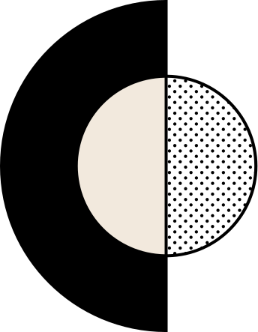
React Structure and Component Design
Component-based layout | Routing handled by react-router
State managed via useState and localStorage | Pages split into logical views: SignIn, Dashboard, ToDo, etc.
CSS handled in one file for global changes | Dynamic routing for database calls
BRIGHTBOARD USES A MODULAR REACT ARCHITECTURE FOR SCALABLE AND MAINTAINABLE CODE.
The WEBSITE is built with reusable components and clean routing for a smooth user experience.

Slide 10
Backend Logic & Database Integration
THE BACKEND IS BUILT WITH FLASK AND CONNECTS DIRECTLY TO MONGODB, POWERING THE WEBSITE’S LOGIC AND DATA HANDLING.
It manages user authentication, learning progress, and course content delivery.
Flask handles routing, form validation, and user sessions
MongoDB used as the main database for all collections
Uses PyMongo to query, insert, and update MongoDB documents
Direct data operations: login validation, user/course lookup

Slide 11
Database Structure & Models
Uses MongoDB as a NoSQL document database | Collections reflect key entities like users, courses, todos
Data stored in JSON-like documents | Relationships managed via references (e.g., usernames, IDs)
PyMongo handles all CRUD operations | Flexible structure allows rapid updates and scaling
BRIGHTBOARD USES MONGODB TO STORE AND MANAGE ALL CORE DATA FOR USERS, COURSES, ASSIGNMENTS, PROGRESS, AND QUIZZES.
Collections are designed to support adaptive learning and user-specific content delivery.

Slide 12
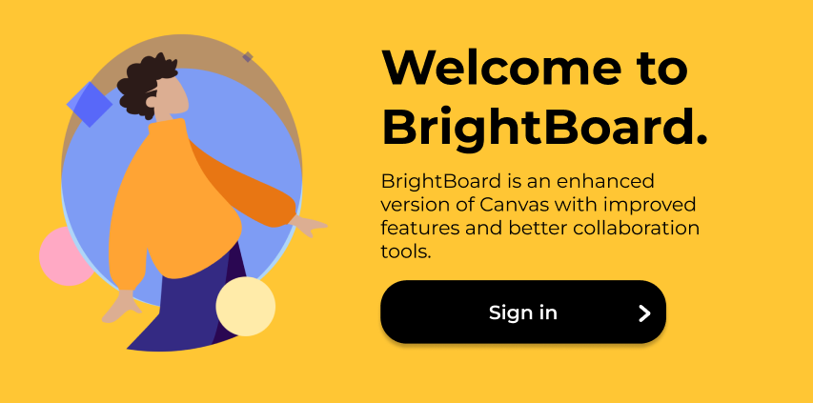
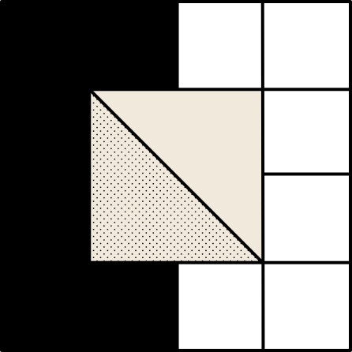
Demo
LIVE DEMO: BRIGHTBOARD IN ACTION
IN THIS DEMO, WE’LL WALK THROUGH THE CORE FEATURES OF BRIGHTBOARD TO SHOWCASE HOW THE PLATFORM IMPROVES THE ONLINE LEARNING EXPERIENCE FOR STUDENTS AND INSTRUCTORS.

Slide 13

Q&A / Feedback
WE’D LOVE TO HEAR YOUR THOUGHTS!
If you have any questions about the platform, development process, or future plans — now’s the time!

